Slide 1
Communication & Network Security
(CNS) Code: EC6112
Semeste: 6th
Branch:E&CSc

Slide 2
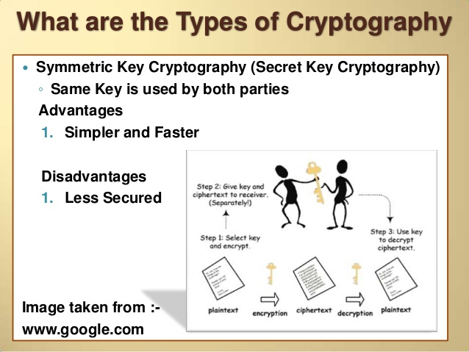
Symmentric Cryptography

Slide 3
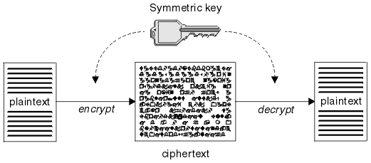
Symmetric-key Encipherment
Alice
Bob

Slide 4
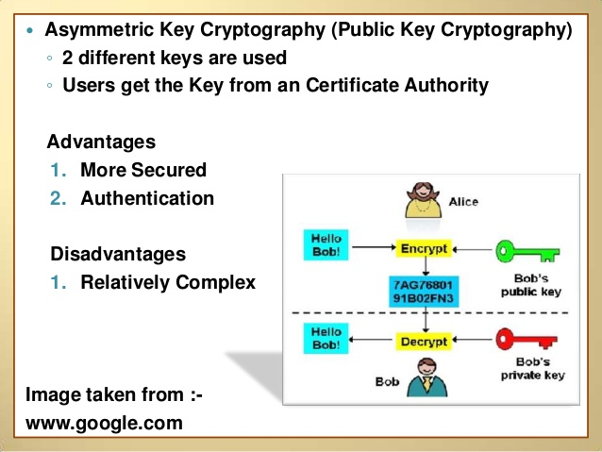
Asymmetric Key Cryptography

Slide 5
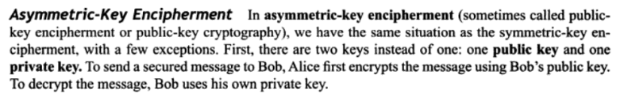
Asymmetric Key Encipherment

Slide 6
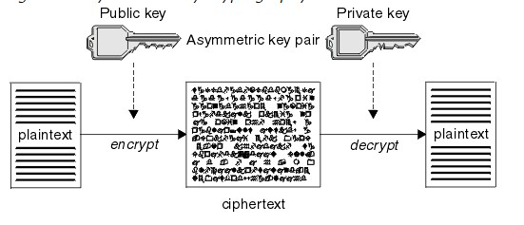
Asymmetric-key Encipherment

Slide 7
SYMMETRIC KEY ENCIPHERMENT
MATHEMETICS OF CRYPTOGRAPHY: PART-I
TRADITIONAL SYMMMETRIC KEY CIPHERS

Slide 8
MATHEMETICS OF CRYPTOGRAPHY: PART-I
INTEGERS
Integer- Division/Divisibility
Greatest Common Divisor (GCD)
Euclidean Algorithm
Extended Euclidean Algorithm
Linear Diophantine Equation
Modular Arithmetic (a Mod b)
Congruence
Inverse – Additive, Multiplicative
MATRICES
Row/Column/Square Matrix
Addition/Subtraction/Multiplication of Matrices
Determinant
Inverse of Matrix- Additive/Multiplicative
Set of Linear Equations

Slide 9
TRADITIONAL SYMMMETRIC KEY CIPHERS
General Idea of Symmetric Key Ciphers
Kerckhoff’s Principle
CRYPTANALYSIS –Attacks
Traditional Ciphers
Substitution Cipher
Mono-Alphabetic Ciphers
Poly-Alphabetic Ciphers
Transposition Cipher

Slide 10
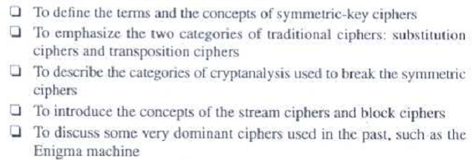
TRADITIONAL SYMMMETRIC KEY CIPHERS

Slide 11
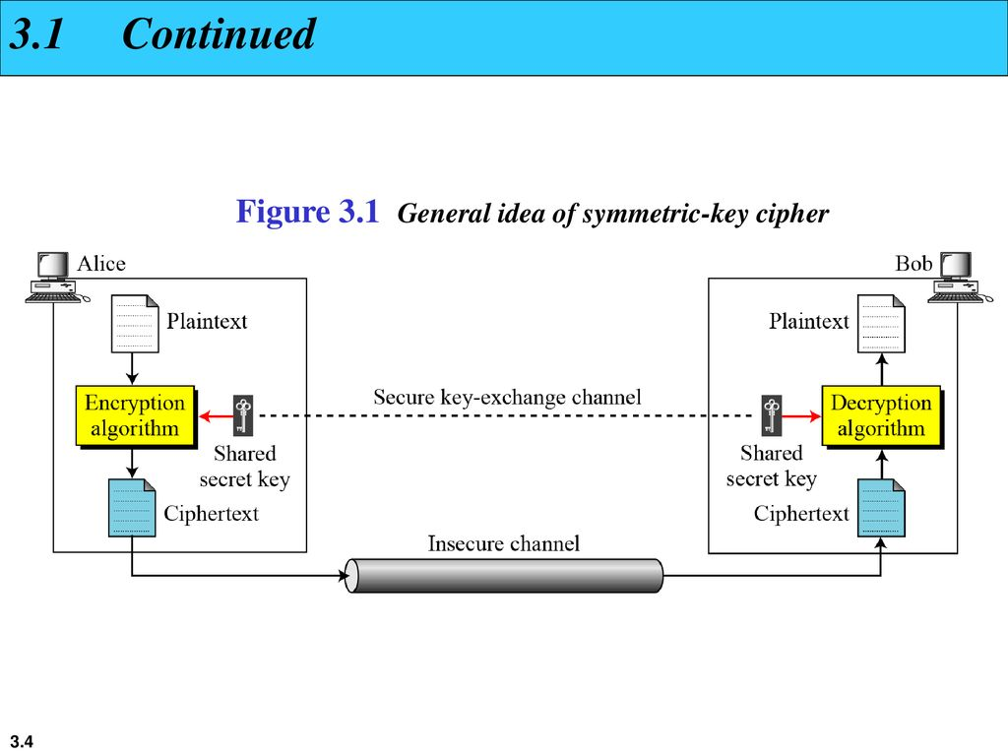
General Idea of Symmetric key Cipher
Plaintext: The original message
from Alice to Bob
Ciphertext: The message that
sent through the channel
Key: A Key is a set of values
(numbers) that the cipher, as a
algorithm, operates on

Slide 12
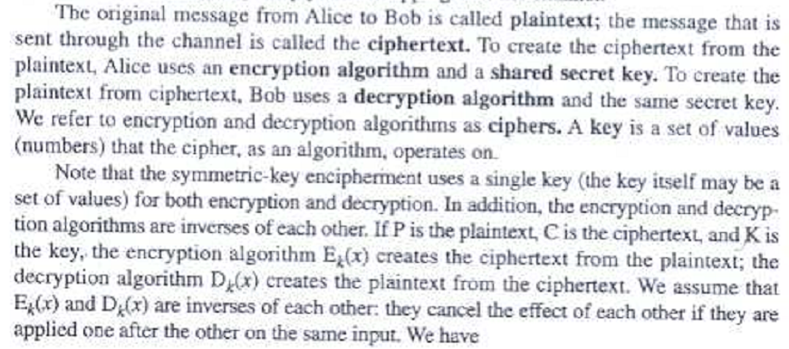
General Idea of Symmetric key Cipher

Slide 13
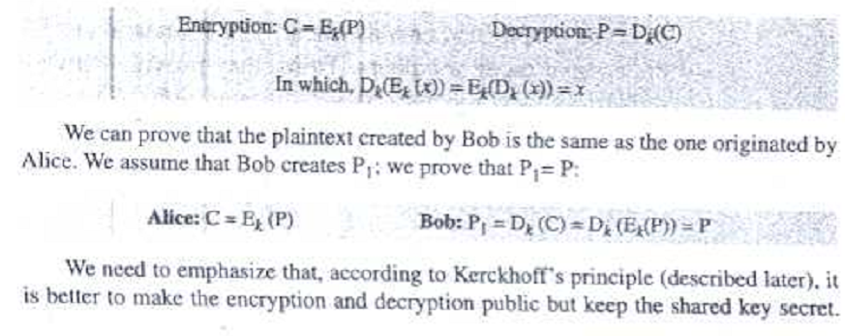
General Idea of Symmetric key Cipher

Slide 14
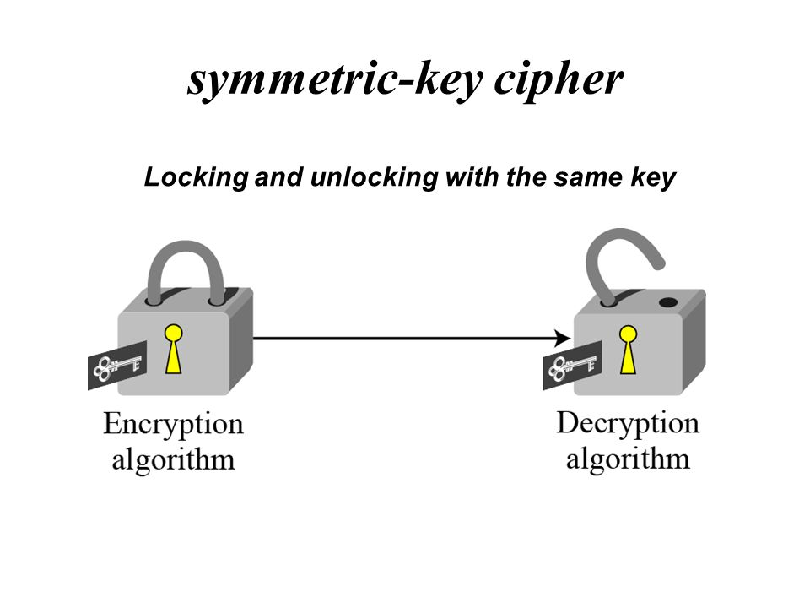
Symmentric-Key cipher

Slide 15
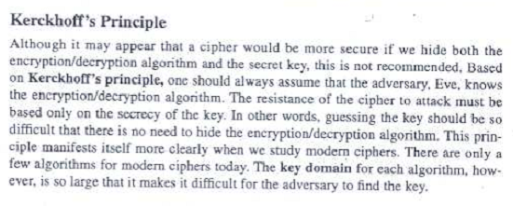
Kerckhoff’s Principle

Slide 16
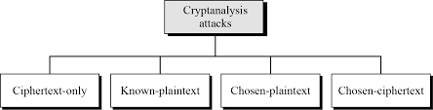
Cryptanalysis Attacks

Slide 17
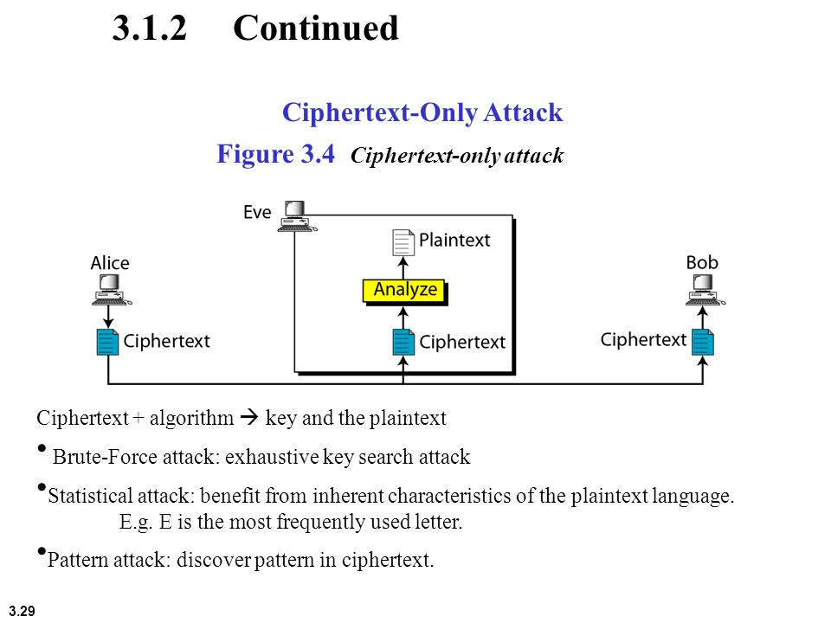
Ciphertext-Only Attack

Slide 18
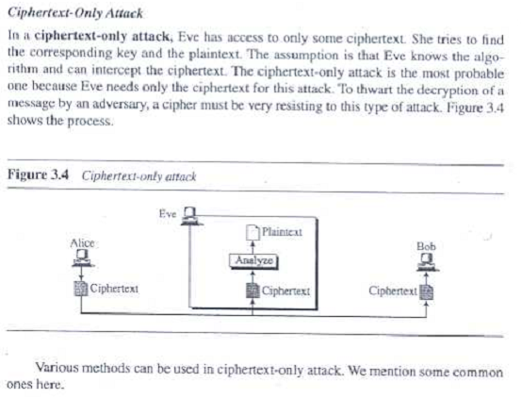
Ciphertext-Only Attack cont...

Slide 19
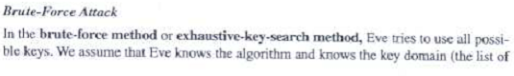
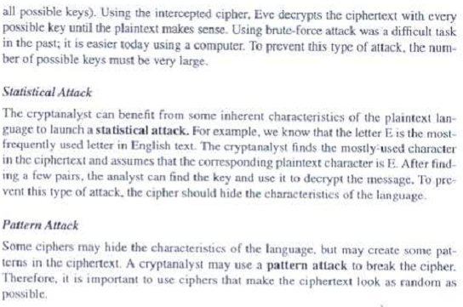

Slide 20
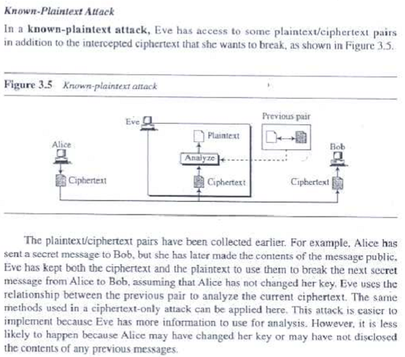
Known-Plaintext Attack

Slide 21
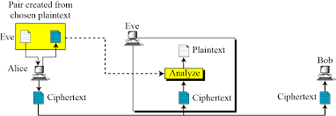
Chosen plaintext

Slide 22
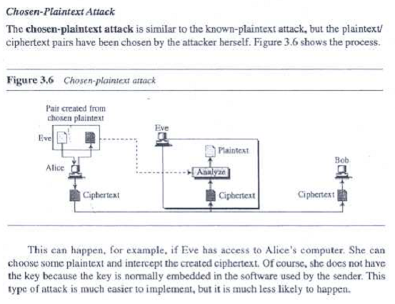

Slide 23
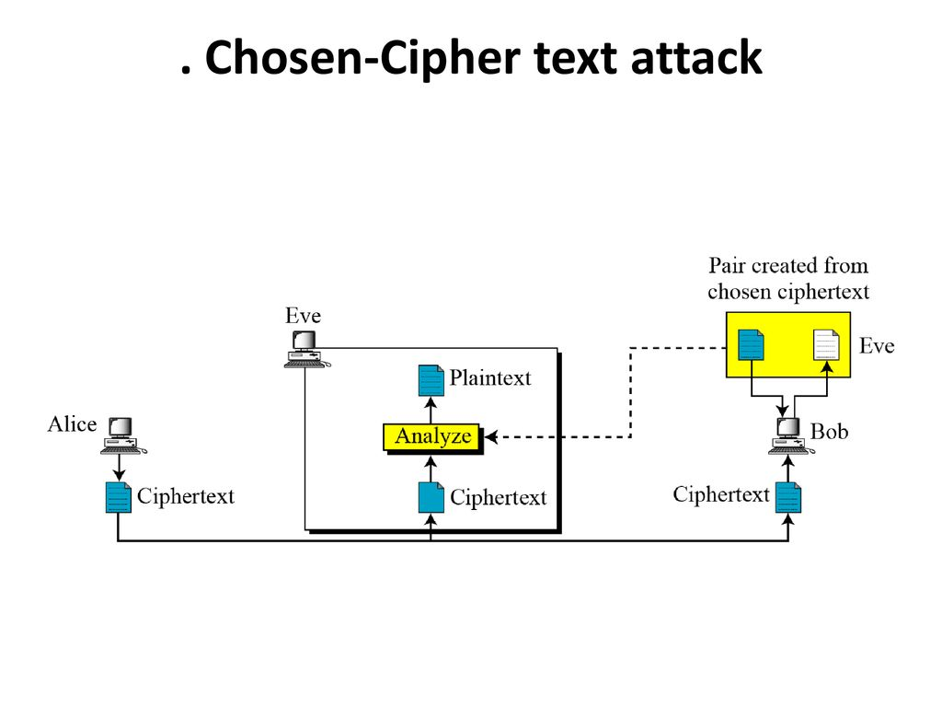
Chosen-Cipher text attack

Slide 24
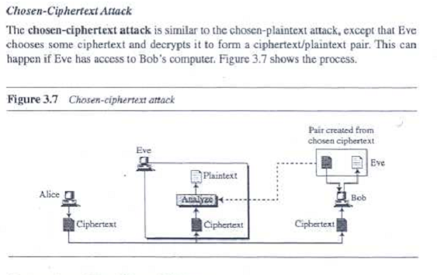

Slide 25
Traditional Ciphers
A. Substitution Cipher
Mono-Alphabetic Ciphers
Poly-Alphabetic Ciphers
B. Transposition Cipher

Slide 26
Substitution Cipher
Mono-Alphabetic Cipher
Additive Cipher/ Shift Cipher/ Caesar Cipher
Multiplicative Cipher
Affine Cipher (combination of Additive Multiplicative Cipher )
Poly-Alphabetic Cipher
Auto-key Cipher
Playfair Cipher
Vigenere Cipher
Hill Cipher
Rotor Cipher- Enigma Machine

Slide 27
Transposition Cipher
Key-less Transposition Cipher
Keyed Transposition Cipher
Combined Two Approach
Using Matrices:
Statistical Attack
Brute-Force Attack
Pattern Attack
Double Transposition Cipher
Stream/ Block Cipher

Slide 28
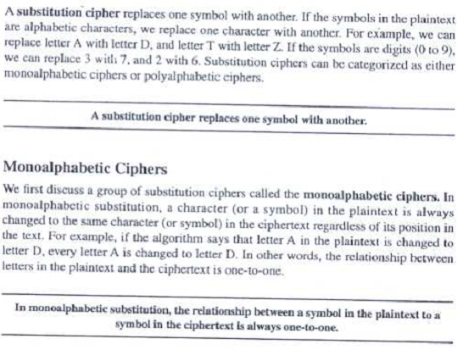
Substitution Cipher

Slide 29
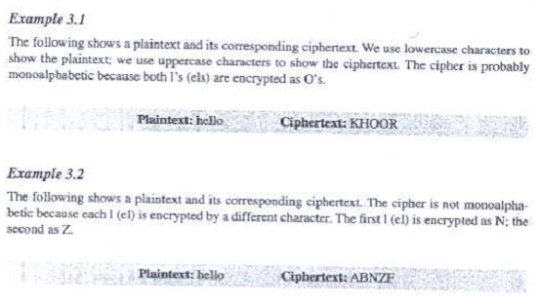

Slide 30
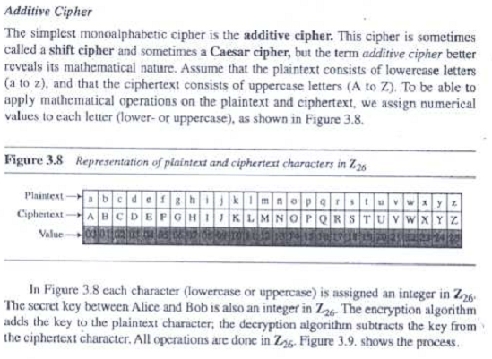
Additive Cipher

Slide 31
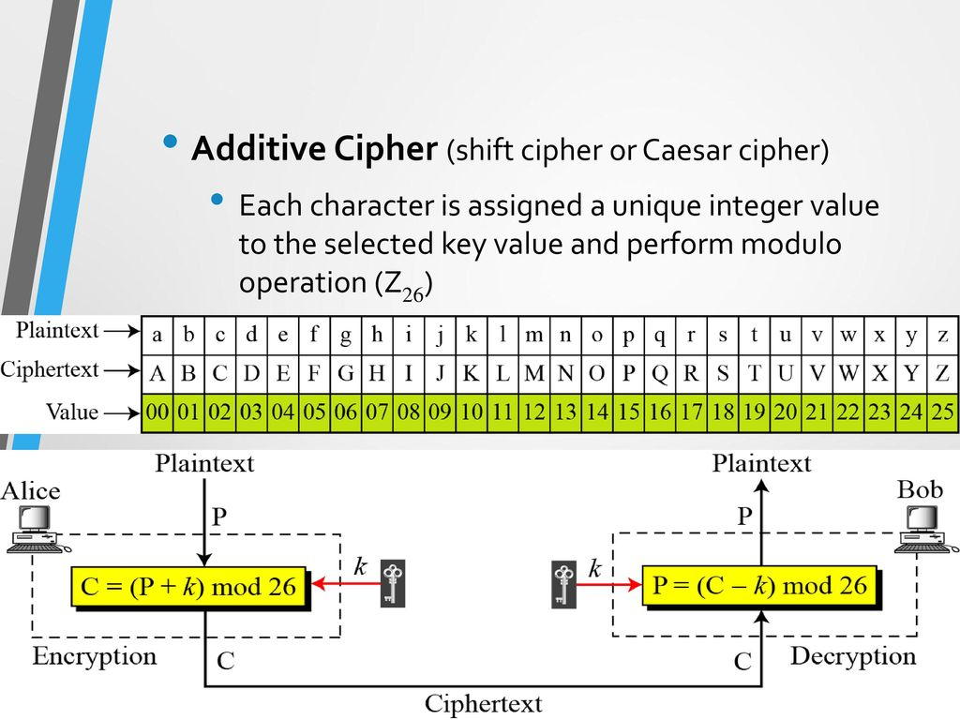
Representation of plaintex and ciphertext in additive cipher

Slide 32
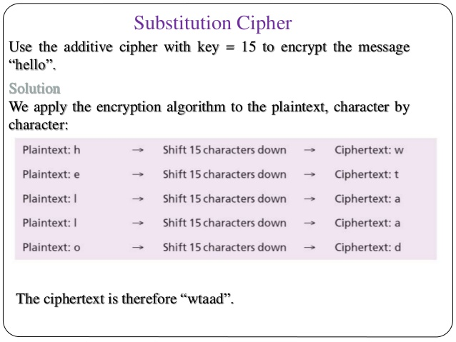
Additive cipher Encrypt Example

Slide 33
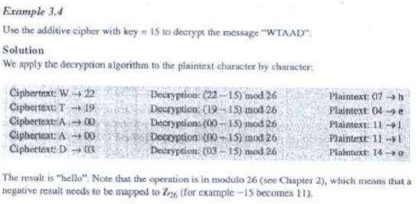
Additive cipher Decrypt Example of

Slide 34
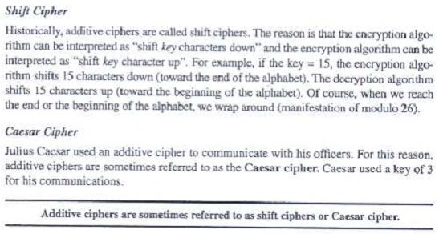
Additive/ Shift/Caesar Cipher

Slide 35
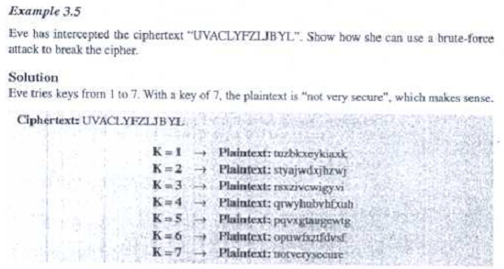
CRYPT-ANALYSIS (Brute-Force Attack)

Slide 36
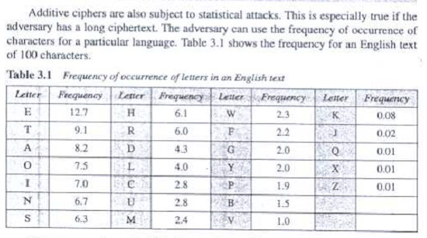
CRYPT-ANALYSIS (Statistical Attack)

Slide 37
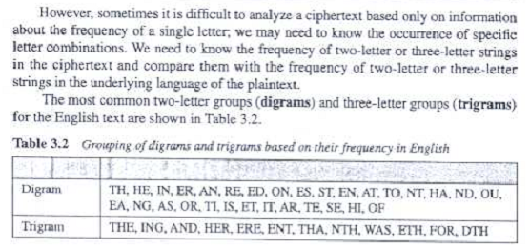
CRYPT-ANALYSIS (Statistical Attack) cont..

Slide 38
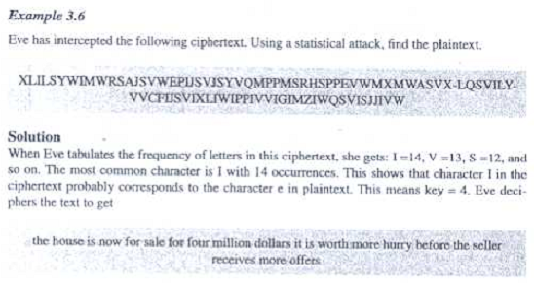
Example of CRYPT-ANALYSIS (Statistical Attack)

Slide 39
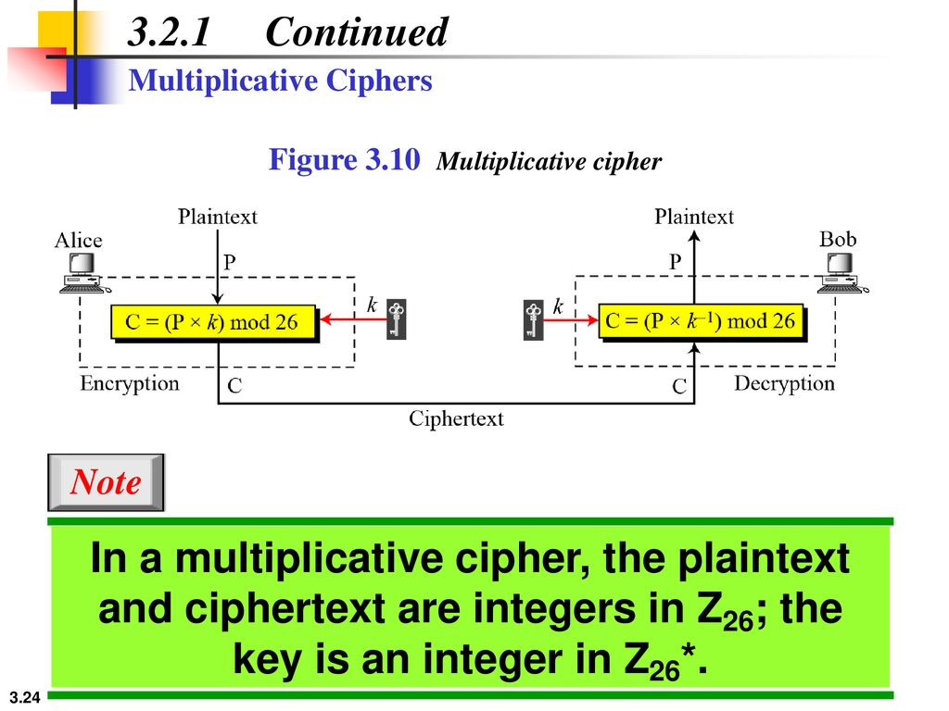
Multiplicative Cipher

Slide 40
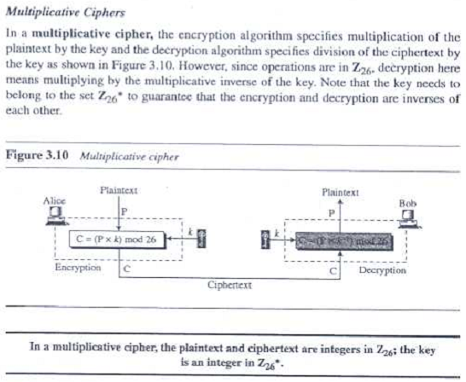
Multiplicative Cipher

Slide 41
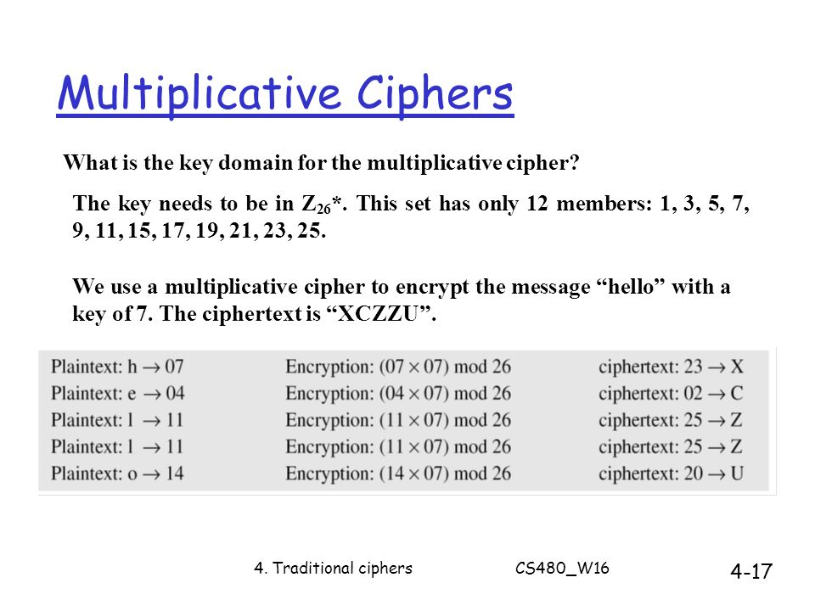
Example of Multiplicative Cipher

Slide 42
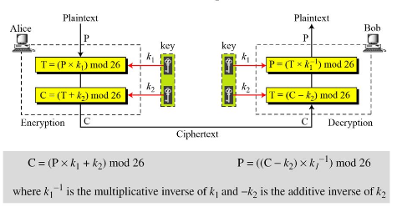
Affine Cipher

Slide 43
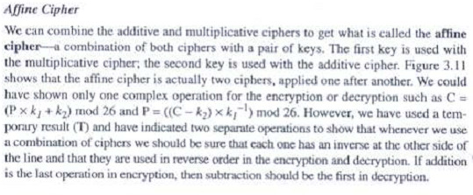
Affine Cipher cont...

Slide 44
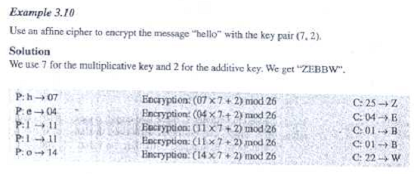
Encrypt example of Affine Cipher

Slide 45
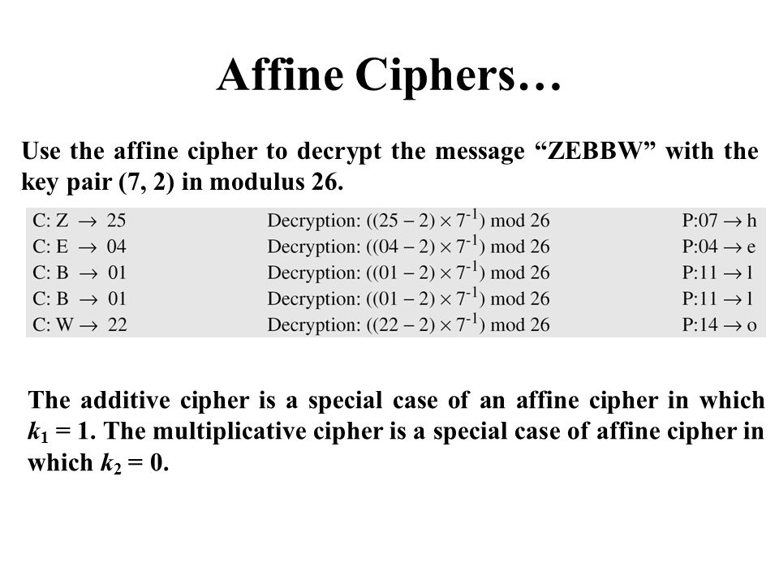
Decrypt example of Affine Cipher

Slide 46
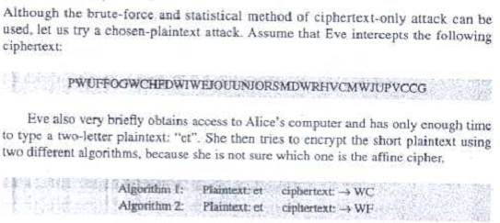
CRYPT-ANALYSIS on Affine Cipher (Statistical Attack)

Slide 47
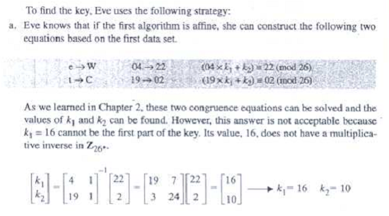
CRYPT-ANALYSIS on Affine Cipher (Statistical Attack) cont...

Slide 48
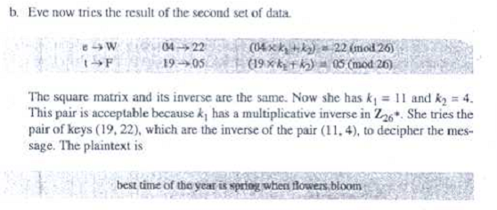
CRYPT-ANALYSIS on Affine Cipher (Statistical Attack) cont..

Slide 49
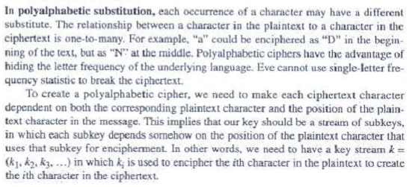
Poly- alphabetic Cipher

Slide 50
Poly- alphabetic Cipher
Auto-key Cipher
Vigenere Cipher
Hill Cipher
Rotor Cipher- Enigma Machine
Playfair Cipher

Slide 51
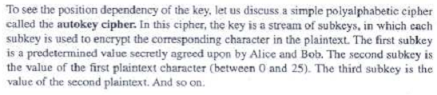
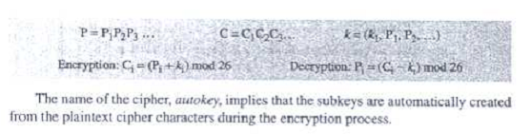
Auto-key Cipher

Slide 52
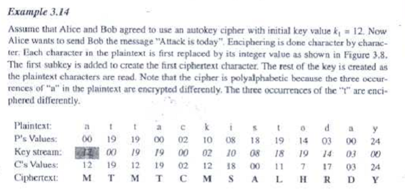
Auto-key Cipher Example

Slide 53
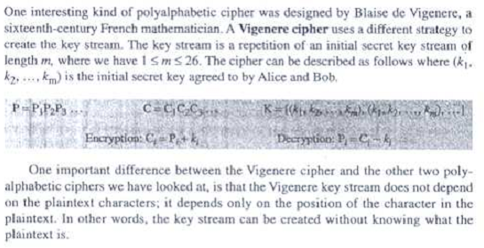
2. Vigenere Cipher

Slide 54
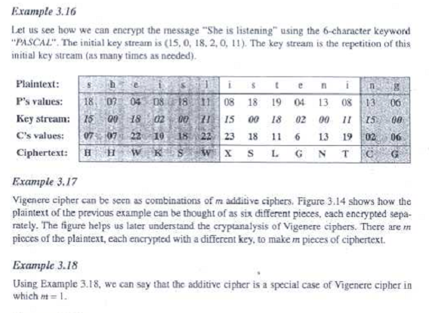
Vigenere Cipher Example

Slide 55
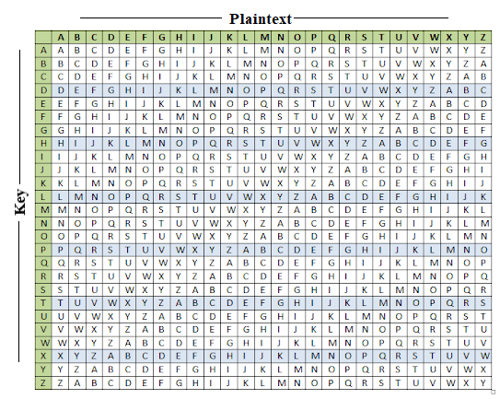
Vigenere Table

Slide 56
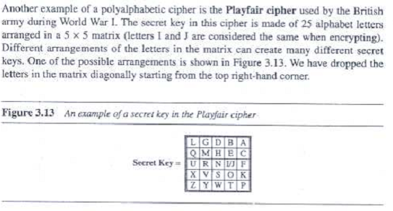
Playfair Cipher

Slide 57

Playfair Cipher

Slide 58

Playfair Cipher

Slide 59

Playfair Cipher Example

Slide 60

Playfair Cipher Example

Slide 61

Hill Cipher

Slide 62

Hill Cipher

Slide 63

Hill Cipher Example

Slide 64

Hill cipher

Slide 65
Transposition Cipher
Key-less Transposition Cipher
Keyed Transposition Cipher
Combined Two Approach
Using Matrices:
Statistical Attack
Brute-Force Attack
Pattern Attack
Double Transposition Cipher
Stream/ Block Cipher

Slide 66


Transposition Cipher

Slide 67

Key-less Transposition Cipher

Slide 68

Key-less Transposition Cipher (rail fence pher)

Slide 69

Key-less Transposition Cipher

Slide 70

Key-less Transposition Cipher
Ciphertext
plaintext

Slide 71

Keyed Transposition Cipher

Slide 72

Keyed Transposition Cipher
enemy attac kston ightx
EEMYN TAACT TKONS HITZG

Slide 73

Combined Two Approach

Slide 74

Combined Two Approach

Slide 75

Combined Two Approach

Slide 76

Double Transposition Ciphers

Slide 77

Double Transposition Cipher

